Slide 1
Topic: Substitution EQ: how you we substitute pronumerals for values?
Year 11 Essentials

Slide 2
Things Required For This Lesson
Interactive Notebook
Textbook: Interleaved Maths Essential Connections
Ruler, Red Pen, Pencil, Pens, Scientific Calculator
Growth mindset

Slide 3

24
7
30
Topic: Substitution
EQ:how you we substitute pronumerals for values?
WICOR
This Photo by Unknown Author is licensed under CC BY-SA

Slide 4
First 5
Simplify 40cm : 2m
Simplify 8y+5y-7x-4x
Divide 60 into the ratio 2:3?
IF a=2 and b=6, what is 5a+2b?
5.What has 13 hearts, but no other organs?
Answers
1:5
13y+13x
24:36
22
A Deck of cards

Slide 5

From yesterday
After simplifying the post-it notes we were left with -2y and +2 g
If a yellow was worth $2 and a green was worth $3, how much money would you have?
-2 x $2 + 2 x $3 = $2

Slide 6
24
7
30
Topic: Substitution
EQ: How you we substitute pronumerals for values?
What is substitution?
Substitution is where we replace a pronumeral (letter) with a number
Example: IF a=2 and b=6, what is 5a+2b?
5x2 + 2x6
=10+ 12
=22
Steps
Replace the pronumeral with the number
Solve
WICOR

Slide 7

Practice
If y=1 and g=3 solve
-3y +2g -2y-1g
+2y -3 +2y -3g
-4g +2y -4y+2g
IF y=4, g=2, x=1 and w=3 solve
-3w +2y -2g -4y +1w+5g
+3y-2x-y+5x
-2y-2x+4y+3y

Slide 8
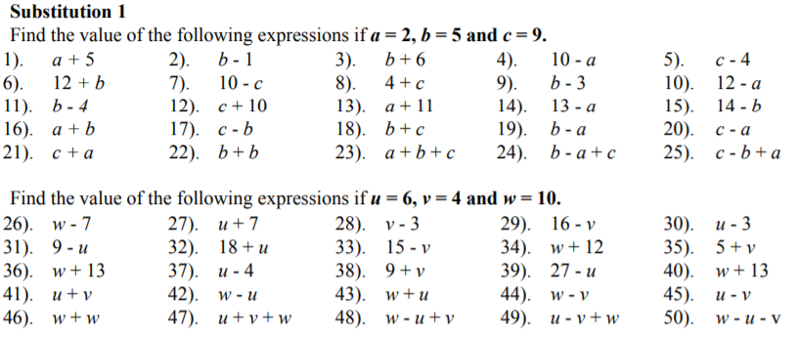

Slide 9

Thank you
Keep up the good work!
Quote of the day –
“Hey Mr Craig, where’s the beef?”- Mr Power

